Slide 1
Applied Data Science Capstone Presentation
Gianluca Contegno • 19 August 2025
Notes:
Intro: who you are, what this project is, and what the audience will see.

Slide 2
Agenda
Notes:
High-level flow.

Slide 3
Agenda
Project Overview (Problem, Objectives, Scope)
Data Sources & Preparation
Exploratory Data Analysis (EDA)
SQL Exploration Results
Modeling & Evaluation
Dashboard / App
Results & Business Impact
Limitations & Next Steps
References & Appendix
Notes:
Keep the roadmap short.

Slide 4
Project Overview

Slide 5
Problem Statement
Core question and target variable.
Task type (classification/regression) and expected outcome.
Stakeholder value.
Notes:
Make it specific and measurable.

Slide 6
Objectives & Success Criteria
Primary metric and baseline comparison.
Secondary objectives: interpretability, latency, fairness.
Numeric targets where possible.
Notes:
Tie to grading rubric.

Slide 7
Scope & Assumptions
Data sources/timeframe/geography.
Constraints and out-of-scope items.
Notes:
Clarify boundaries.

Slide 8
Exploratory Data Analysis (EDA)

Slide 9
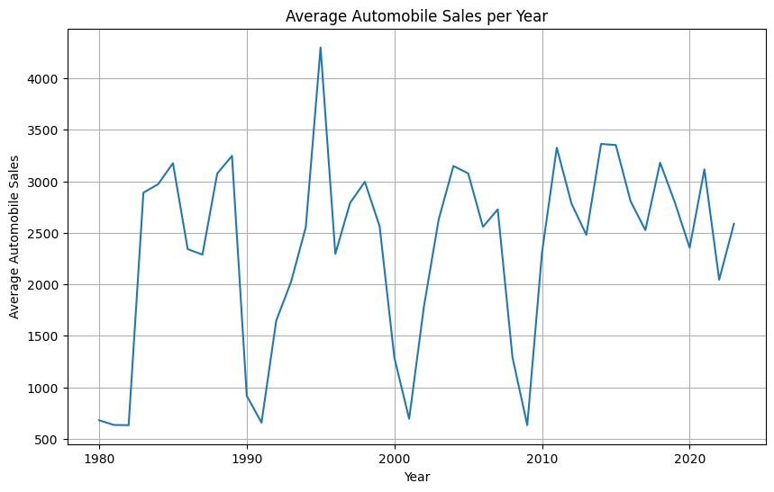
EDA Output • VisualizationFinal-P1-GianlucaContegno (1)
df_line = df.groupby(df['Year'])['Automobile_Sales'].mean() plt.figure(figsize=(10, 6)) df_line.plot(kind='line') plt.xlabel('Year') plt.ylabel('Average Automobile Sales') plt.title('Average Automobile Sales per Year') plt.grid(True) plt.savefig('lineplot_auto_sales_yearly.png') plt.show()
Code groups automobile sales by year and calculates averages.
Line plot shows long-term trends in sales from 1980–2023.
Peaks and dips reflect economic cycles (growth vs. slowdown).
Confirms dataset is useful for studying the impact of recessions on sales.
Notes:
Explain the main insight and impact on feature selection.

Slide 10
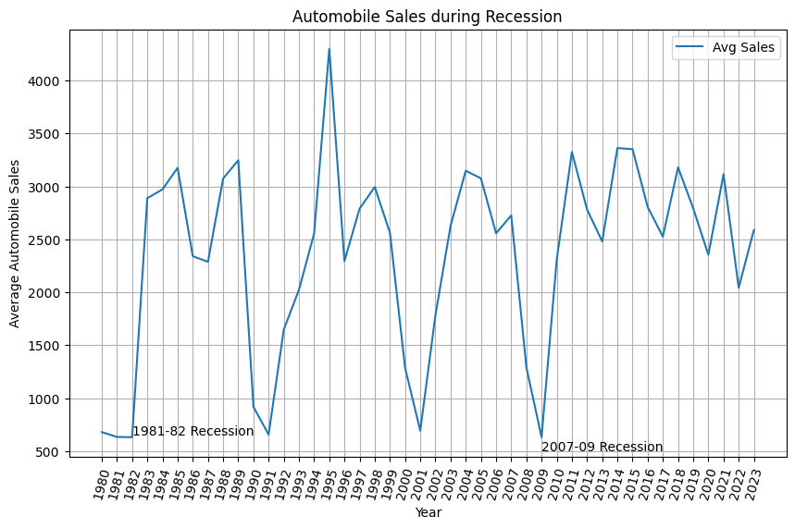
EDA Output • VisualizationFinal-P1-GianlucaContegno (1)
df_line = df.groupby(df['Year'])['Automobile_Sales'].mean() plt.figure(figsize=(10, 6)) df_line.plot(kind='line') plt.xticks(list(range(1980, 2024)), rotation=75) plt.xlabel('Year') plt.ylabel('Average Automobile Sales') plt.title('Automobile Sales during Recession') plt.text(1982, 650, '1981-82 Recession') plt.text(2009, 500, '2007-09 Recession') plt.legend(['Avg Sales']) plt.grid(True) plt.savefig('Line_Plot_1.png') plt.show()
Code highlights recession periods directly on the sales chart.
Sales visibly drop during 1981–82 and 2007–09 recessions.
Confirms economic downturns strongly impact car sales.
Annotations and legend make the pattern easy to interpret.
Notes:
Explain the main insight and impact on feature selection.

Slide 11
EDA Output • VisualizationFinal-P1-GianlucaContegno (1)
df_rec = df[df['Recession'] == 1] df_Mline = df_rec.groupby(['Year', 'Vehicle_Type'], as_index=False)['Automobile_Sales'].mean() df_Mline['Normalized_Sales'] = df_Mline.groupby('Vehicle_Type')['Automobile_Sales'].transform(lambda x: x / x.mean()) df_Mline.set_index('Year', inplace=True) plt.figure(figsize=(12, 8)) for vehicle_type in df_Mline['Vehicle_Type'].unique(): data = df_Mline[df_Mline['Vehicle_Type'] == vehicle_type] plt.plot(data.index, data['Normalized_Sales'], label=vehicle_type, marker='o') recession_years = df_rec['Year'].unique() for year in recession_years: plt.axvline(x=year, color='gray', linestyle='--', alpha=0.5) plt.legend(title="Vehicle Type", bbox_to_anchor=(1.05, 1), loc='upper left') plt.ylabel("Normalized Sales") plt.xlabel("Year") plt.title("Normalized Automobile Sales by Vehicle Type During Recession") plt.tight_layout() plt.savefig("Line_Plot_2.png")
Notes:
Explain the main insight and impact on feature selection.

Slide 12
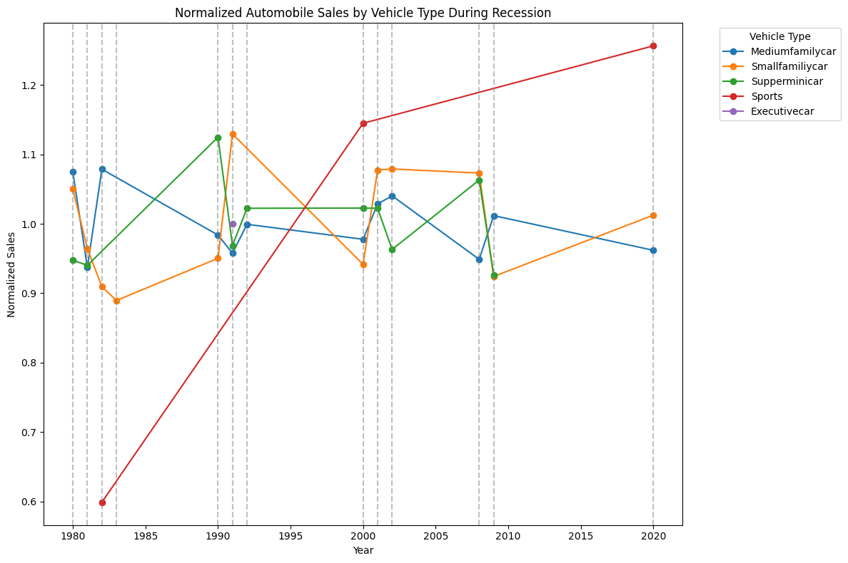
Code normalizes sales for each vehicle type (compared to its own average).
Allows fair comparison between different vehicle types, regardless of scale.
Vertical dashed lines mark recession years.
Insight: Some vehicle types (e.g., executive cars) stay above average, while others drop more
sharply.
Shows how economic downturns affect vehicle categories differently.

Slide 13
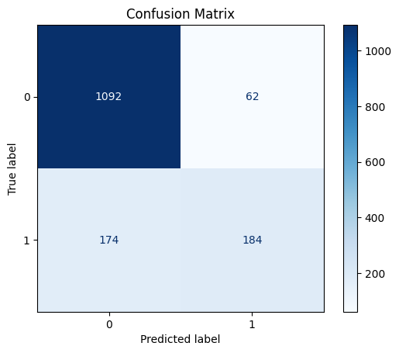
EDA Output • MachineLearningFinal-GianlucaContegno
from sklearn.metrics import confusion_matrix, ConfusionMatrixDisplay import matplotlib.pyplot as plt conf_matrix = confusion_matrix(y_test, y_pred) disp = ConfusionMatrixDisplay(confusion_matrix=conf_matrix) disp.plot(cmap='Blues') plt.title('Confusion Matrix') plt.show()
Code generates a confusion matrix to evaluate classification performance.
Top-left (1092) = correct predictions of “No Rain” (True Negatives).
Bottom-right (184) = correct predictions of “Rain” (True Positives).
Off-diagonal values (62 and 174) = misclassifications.
Insight: Model is good at predicting No Rain, but less accurate for Rain events.
Notes:
Explain the main insight and impact on feature selection.

Slide 14
EDA Output • MachineLearningFinal-GianlucaContegno
# Combine numeric and categorical feature names feature_names = numeric_features + list(grid_search.best_estimator_['preprocessor'] .named_transformers_['cat'] .named_steps['onehot'] .get_feature_names_out(categorical_features)) feature_importances = grid_search.best_estimator_['classifier'].feature_importances_ importance_df = pd.DataFrame({'Feature': feature_names, 'Importance': feature_importances }).sort_values(by='Importance', ascending=False) N = 20 # Change this number to display more or fewer features top_features = importance_df.head(N) # Plotting plt.figure(figsize=(10, 6)) plt.barh(top_features['Feature'], top_features['Importance'], color='skyblue') plt.gca().invert_yaxis() # Invert y-axis to show the most important feature on top plt.title(f'Top {N} Most Important Features in predicting whether it will rain today') plt.xlabel('Importance Score') plt.show()
Notes:
Explain the main insight and impact on feature selection.

Slide 15
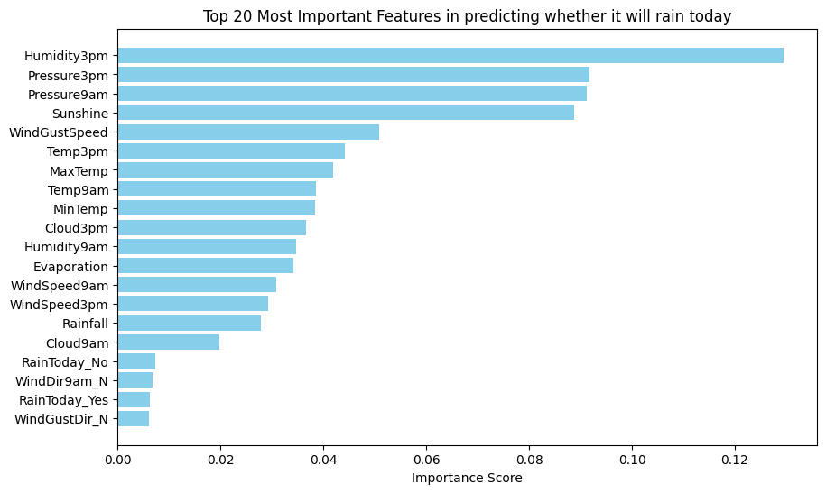
.
Code extracts top 20 most important features used by the model.
Humidity at 3pm and pressure readings are the strongest predictors of rain.
Sunshine and wind-related features also play significant roles.
Feature importance ranking improves interpretability of the model.
Helps stakeholders trust predictions by showing which weather conditions matter most.

Slide 16
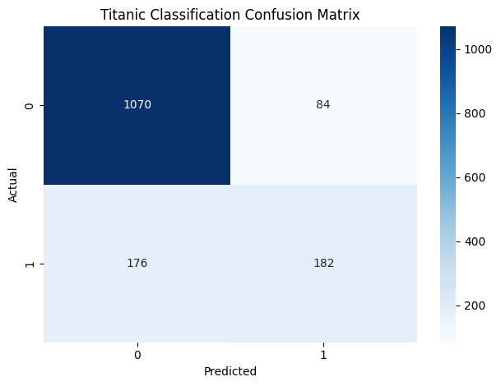
EDA Output • MachineLearningFinal-GianlucaContegno
print(classification_report(y_test, y_pred)) # Generate the confusion matrix conf_matrix = confusion_matrix(y_test, y_pred) plt.figure() sns.heatmap(conf_matrix, annot=True, cmap='Blues', fmt='d') # Set the title and labels plt.title('Titanic Classification Confusion Matrix') plt.xlabel('Predicted') plt.ylabel('Actual') # Show the plot plt.tight_layout() plt.show()
Code generates a confusion matrix for the Titanic survival model.
Top-left (1070) = correctly predicted non-survivors.
Bottom-right (182) = correctly predicted survivors.
Off-diagonals (84 and 176) = misclassifications.
Insight: Model is stronger at predicting non-survivors than survivors.
Reflects dataset imbalance (more passengers died than survived).
Notes:
Explain the main insight and impact on feature selection.

Slide 17
SQL Exploration Results

Slide 18
Schema & Queries
Tables, joins, and row counts.
Representative aggregations and window functions.
How SQL informed data readiness.
Notes:
Refer to appendix for full query snippets.

Slide 19
Key SQL Findings
Segments with high/low outcome rates.
Anomalies discovered and addressed.
Notes:
Bridge toward modeling.

Slide 20
Modeling & Evaluation

Slide 21
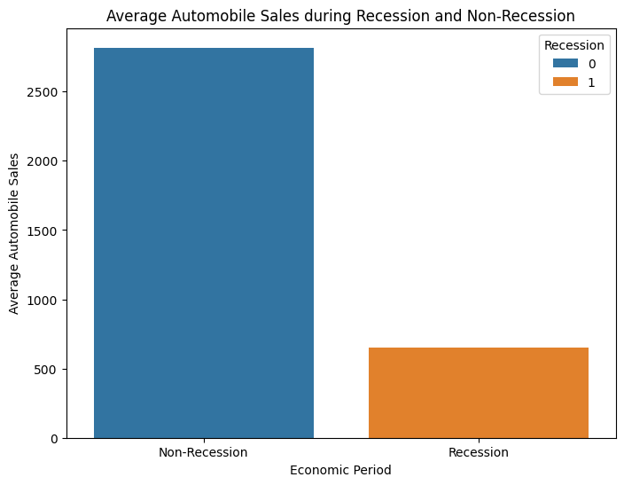
Model Development • VisualizationFinal-P1-GianlucaContegno (1)
new_df = df.groupby('Recession')['Automobile_Sales'].mean().reset_index() plt.figure(figsize=(8, 6)) sns.barplot(x='Recession', y='Automobile_Sales', hue='Recession', data=new_df) plt.xlabel('Economic Period') plt.ylabel('Average Automobile Sales') plt.title('Average Automobile Sales during Recession and Non-Recession') plt.xticks(ticks=[0, 1], labels=['Non-Recession', 'Recession']) plt.savefig('Seaborn_Barplot_1.png') plt.show()
Code groups sales data by economic period (recession vs non-recession).
Bar plot shows a sharp decline in sales during recessions.
Confirms strong negative relationship between recessions and auto sales.
Key insight: downturns significantly reduce demand across the industry.
Notes:
State model, key hyperparameters, and rationale.

Slide 22
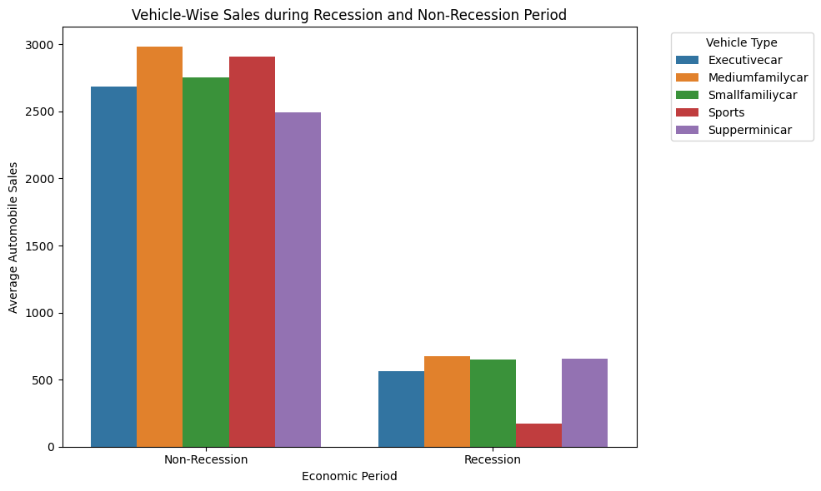
Model Development • VisualizationFinal-P1-GianlucaContegno (1)
grouped_df = df.groupby(['Recession', 'Vehicle_Type'])['Automobile_Sales'].mean().reset_index() plt.figure(figsize=(10, 6)) sns.barplot(x='Recession', y='Automobile_Sales', hue='Vehicle_Type', data=grouped_df) plt.xticks(ticks=[0, 1], labels=['Non-Recession', 'Recession']) plt.xlabel('Economic Period') plt.ylabel('Average Automobile Sales') plt.title('Vehicle-Wise Sales during Recession and Non-Recession Period') plt.legend(title='Vehicle Type', bbox_to_anchor=(1.05, 1), loc='upper left') plt.tight_layout() plt.savefig("Seaborn_Barplot_2.png") # plt.show()
Code groups data by vehicle type and economic period.
Bar plot compares average sales of each vehicle type in recession vs non-recession.
Insight: All vehicle types drop in sales during recessions, but the magnitude varies
Economy/family cars show smaller declines, while higher-end vehicles fall more sharply.
Confirms recessions impact different market segments unequally.
Notes:
State model, key hyperparameters, and rationale.

Slide 23
Model Development • VisualizationFinal-P1-GianlucaContegno (1)
rec_data = df[df['Recession'] == 1] non_rec_data = df[df['Recession'] == 0] fig = plt.figure(figsize=(12, 6)) ax0 = fig.add_subplot(1, 2, 1) sns.lineplot(x='Year', y='GDP', data=rec_data, label='Recession', ax=ax0) ax0.set_xlabel('Year') ax0.set_ylabel('GDP') ax0.set_title('GDP Variation during Recession Period') ax1 = fig.add_subplot(1, 2, 2) sns.lineplot(x='Year', y='GDP', data=non_rec_data, label='Non-Recession', ax=ax1) ax1.set_xlabel('Year') ax1.set_ylabel('GDP') ax1.set_title('GDP Variation during Non-Recession Period') plt.tight_layout() plt.savefig('GDP_Subplots.png') plt.show()
Notes:
State model, key hyperparameters, and rationale.

Slide 24
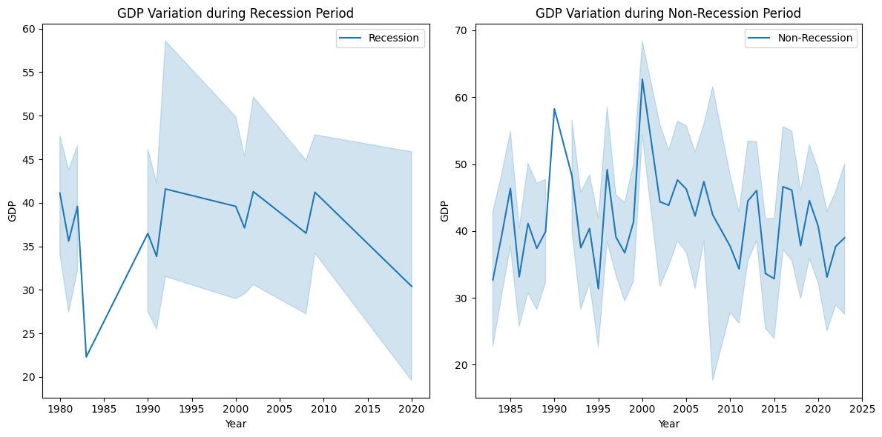
Code splits GDP data into recession and non-recession subsets. Left chart: GDP trends during recession years. Right chart: GDP trends during non-recession years. Insight: GDP shows more instability and lower values in recessions. Confirms macroeconomic health is closely tied to automobile sales.

Slide 25
Model Development • MachineLearningFinal-GianlucaContegno
from sklearn.metrics import classification_report, confusion_matrix import seaborn as sns import matplotlib.pyplot as plt print("Classification Report (Logistic Regression):") print(classification_report(y_test, y_pred)) conf_matrix = confusion_matrix(y_test, y_pred) plt.figure() sns.heatmap(conf_matrix, annot=True, cmap='Blues', fmt='d') plt.title('Rain Prediction Confusion Matrix – Logistic Regression') plt.xlabel('Predicted') plt.ylabel('Actual') plt.tight_layout() plt.show()
Notes:
State model, key hyperparameters, and rationale.

Slide 26
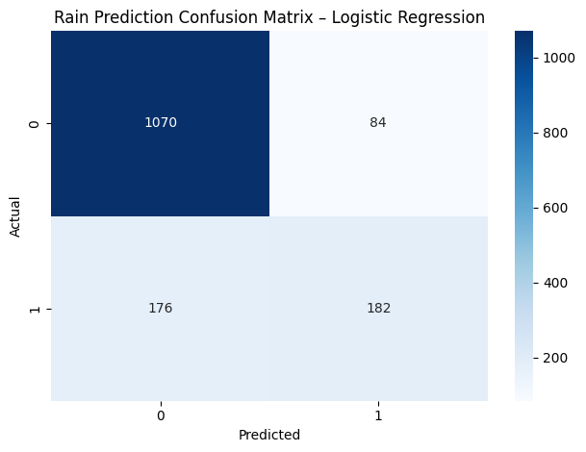
Logistic Regression model used to predict “Will it rain today?” Classification report provides precision, recall, and F1-score for evaluation. Confusion matrix shows correct and incorrect classifications: 1070 = correctly predicted “No Rain” 182 = correctly predicted “Rain” 84 and 176 = misclassifications Insight: Model performs well overall, but less accurate on predicting rain (minority class). Demonstrates strengths and limitations of Logistic Regression in weather prediction.

Slide 27
Evaluation Metrics • VisualizationFinal-P1-GianlucaContegno (1)
non_rec_data = df[df['Recession'] == 0] plt.figure(figsize=(10, 6)) sns.scatterplot( data=non_rec_data, x='Month', y='Automobile_Sales', size='Seasonality_Weight', sizes=(20, 300), legend=False ) plt.xlabel('Month') plt.ylabel('Automobile Sales') plt.title('Seasonality Impact on Automobile Sales') plt.savefig("Bubble.png") plt.show()
Notes:
Interpret FP/FN, ROC/PR, or error trends.

Slide 28
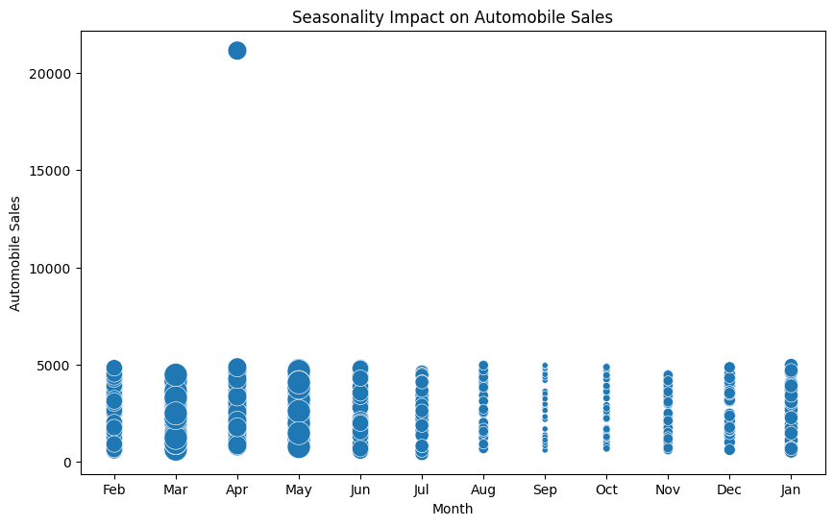
Code creates a bubble scatter plot, with bubble size based on seasonality weight. X-axis = months, Y-axis = automobile sales. Larger bubbles represent stronger seasonal effects. Insight: Sales peak around certain months (e.g., spring/early summer, holidays). Confirms seasonality is an important predictor of demand.

Slide 29
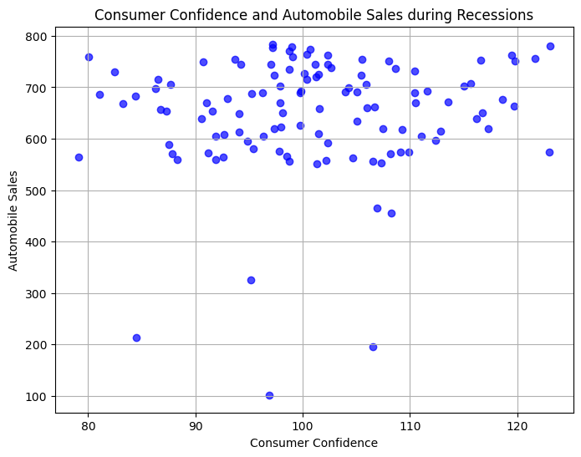
Evaluation Metrics • VisualizationFinal-P1-GianlucaContegno (1)
rec_data = df[df['Recession'] == 1] plt.figure(figsize=(8, 6)) plt.scatter(rec_data['Consumer_Confidence'], rec_data['Automobile_Sales'], color='blue', alpha=0.7) plt.xlabel('Consumer Confidence') plt.ylabel('Automobile Sales') plt.title('Consumer Confidence and Automobile Sales during Recessions') plt.grid(True) plt.savefig('Scatter.png') plt.show()
Code creates a scatter plot of consumer confidence vs. auto sales.
Each dot = sales level for a given confidence score during a recession year.
Positive relationship: higher consumer confidence → higher car sales.
Insight: Economic sentiment is a strong external predictor of demand.
Confirms sales are not only seasonal but also sensitive to consumer outlook
Notes:
Interpret FP/FN, ROC/PR, or error trends.

Slide 30
Dashboard / App

Slide 31
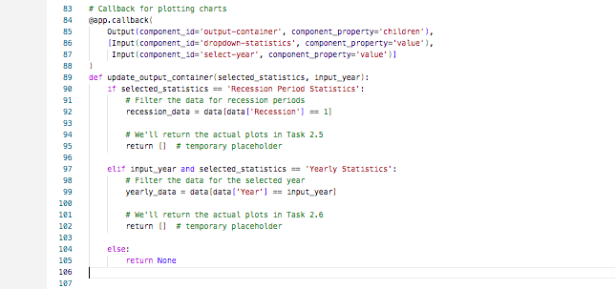
App Component • Callback
Code defines callbacks in Dash to update charts interactively.
Connects dropdown selections (statistics type) and year input to output graphs.
Example: If user selects Recession Statistics, filters data only for recession periods.
If user selects Yearly Statistics, filters data for the chosen year.
Key insight: Enables real-time interaction with the dashboard for flexible analysis.
Notes:
Explain how Callback supports user interaction or reporting.

Slide 32
App Component • Outputdiv
Defines an HTML division (Div) in Dash for output display.
id='output-container' → placeholder where graphs and results will be rendered.
className='chart-grid' with flex styling → ensures charts align neatly in layout.
Essential for dynamically showing results when users interact with the dashboard
Notes:
Explain how Outputdiv supports user interaction or reporting.

Slide 33
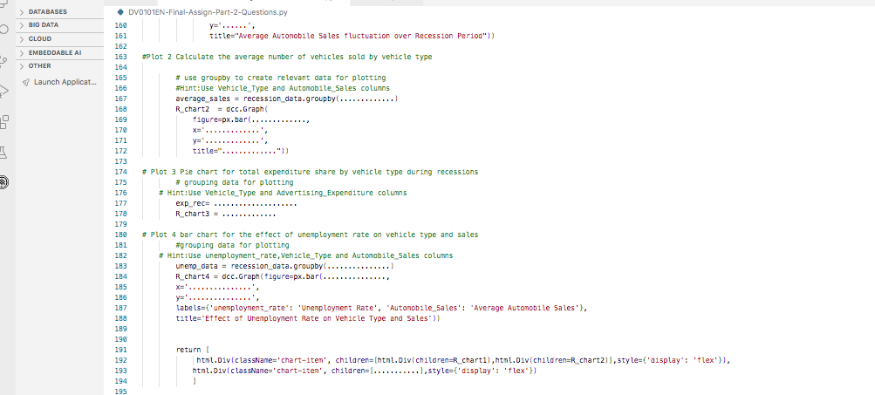
App Component • RecessionReportGraphs
Notes:
Explain how RecessionReportGraphs supports user interaction or reporting.

Slide 34
Dashboard App Component (Recession Report Graphs)
Code generates multiple graphs focused on recession analysis.
Includes:
Average automobile sales during recession periods.
Sales by vehicle type during recessions.
Expenditure share and unemployment rate effects on sales.
Each graph is rendered inside a flexible layout (Div) for clear visualization.
Insight: Dashboard helps users explore different economic factors affecting sales.

Slide 35
Results & Impact

Slide 36
Key Results • Recession Report Graphs
Dashboard generates interactive graphs summarizing recession impacts.
Results confirm:
Average sales decline significantly during recession periods.
Vehicle types are affected differently (economy vs. luxury).
Unemployment and advertising expenditure also influence sales trends.
Insight: Businesses can anticipate downturn effects and adjust strategy accordingly.
Notes:
Summarize trends and their implications.

Slide 37
Business Value
Improvement vs baseline (metric).
Operational benefits (speed/cost/coverage).
Clear recommendations.
Notes:
Make the case for adoption.

Slide 38
Model Demos (Videos)

Slide 39
Demo Video • Decision Tree Presentation Gianluca Contegno.mov
▶ Play video: Decision Tree Presentation Gianluca Contegno.mov (Place this PPTX in the same folder as the video to enable the link.)
Open Decision Tree Presentation Gianluca Contegno.mov
Notes:
Click to play if co-located. Otherwise, see submission folder.

Slide 40
Demo Video • KNN Contegno .mov
▶ Play video: KNN Contegno .mov (Place this PPTX in the same folder as the video to enable the link.)
Open KNN Contegno .mov
Notes:
Click to play if co-located. Otherwise, see submission folder.

Slide 41
Limitations & Next Steps

Slide 42
Limitations
Data coverage/bias/noise.
Model drift or generalization limits.
Latency/compute constraints.
Notes:
Transparency earns points.

Slide 43
Next Steps
Collect richer features and more recent data.
Improve calibration/monitoring and retraining schedule.
A/B test via incremental rollout.
Notes:
Actionable, time-bound steps.

Slide 44
References & Appendix

Slide 45
References
Jupyter notebooks and datasets (see appendix).
Library documentation (e.g., scikit-learn, pandas, matplotlib).
Notes:
Ensure citations are consistent with course expectations.

Slide 46
Appendix • VisualizationFinal-P1-GianlucaContegno (1)
Notes:
Supplementary detail.

Slide 47
– Appendix (Average Automobile Sales per Year)
Line chart of yearly average automobile sales from 1980–2023.
Confirms long-term fluctuations tied to economic cycles.
Supporting visualization for EDA findings.

Slide 48
Appendix • VisualizationFinal-P1-GianlucaContegno (1)
Notes:
Supplementary detail.

Slide 49
(Appendix) showing the Automobile Sales during Recession with recession years annotated.
Line chart of auto sales with recession periods labeled.
Sales dips clearly visible in 1981–82 and 2007–09 recessions.
Reinforces main analysis: economic downturns reduce sales.

Slide 50
Appendix • VisualizationFinal-P1-GianlucaContegno (1)
Notes:
Supplementary detail.

Slide 51
– Appendix (Normalized Sales by Vehicle Type During Recession)
Sales normalized by vehicle type to compare trends fairly.
Vertical dashed lines mark recession years.
Insight: Some vehicle types (e.g., executive cars) stayed above average, while others dipped
more sharply.
Supports main finding: recessions affect categories differently.

Slide 52
Appendix • VisualizationFinal-P1-GianlucaContegno (1)
Notes:
Supplementary detail.

Slide 53
– Appendix (Average Sales: Recession vs Non-Recession)
Bar plot comparing average automobile sales in recession vs non-recession.
Sales drop sharply in recession years.
Supports main finding: downturns directly reduce demand.

Slide 54
Appendix • VisualizationFinal-P1-GianlucaContegno (1)
Notes:
Supplementary detail.

Slide 55
Appendix (Vehicle-Wise Sales in Recession vs Non-Recession)
Bar plot breaks down sales by vehicle type across economic periods.
All vehicle types fall in recessions, but some categories (e.g., sports/luxury cars) fall more steeply.
Reinforces insight: market segments respond differently to downturns.

Slide 56
Appendix • VisualizationFinal-P1-GianlucaContegno (1)
Notes:
Supplementary detail.

Slide 57
Appendix (GDP Variation in Recession vs Non-Recession)
Left chart: GDP patterns during recessions → more unstable and lower values.
Right chart: GDP in non-recession years → steadier and higher.
Confirms GDP is a key external driver of automobile sales.

